Slide 1
Linear Regression - 실습
컴퓨터AI공학부
2024년 2학기 머신러닝

Slide 2
실습 개요
Linear Regression (선형회귀)
Single Linear Regression (단일 선형회귀)
Solutions
Ordinary Least Squares (OLS) = Least Squares Method (LSM) = Normal Equation
Gradient Descent Method
y
y = wx + b
x
단일 선형회귀 예시

Slide 3
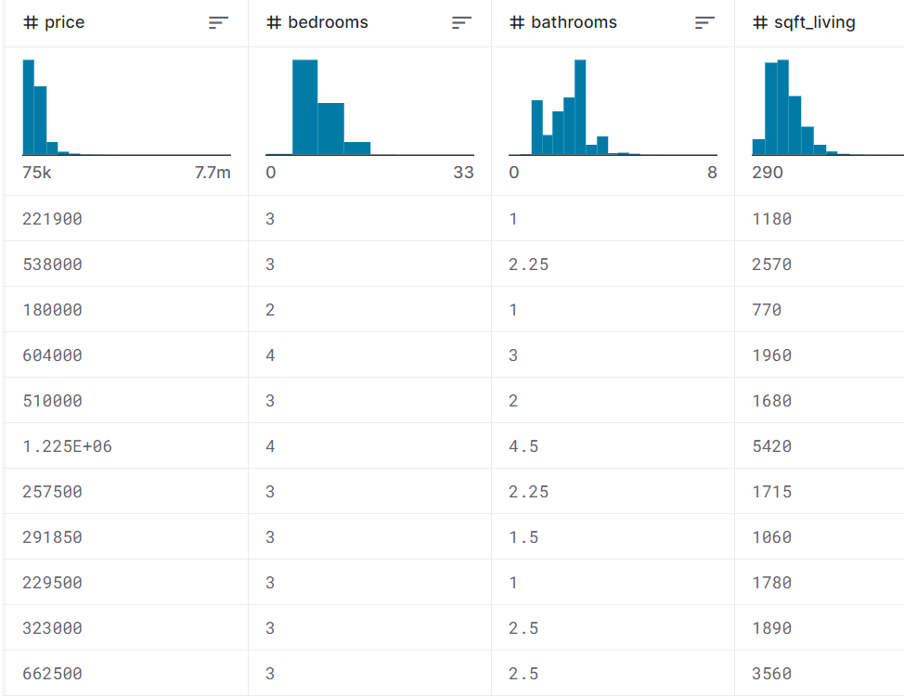
실습 개요
Dataset: kc_house_data
2014 ~ 2015년 사이 판매된 주택 가격 데이터셋
21개 변수, 21,613개 데이터로 구성됨
가격
침실
화장실
크기
…
…
https://www.kaggle.com/datasets/shivachandel/kc-house-data/

Slide 4


실습 환경 구성
Google Colaboratory (Colab)
딥러닝, 머신러닝 모델 등을 실행할 수 있는 무료 클라우드 서비스
모델 학습을 위해 GPU를 일정 시간동안 무료로 사용할 수 있음
구글 계정으로 로그인해 사용 가능 (colab.research.google.com)

Slide 5

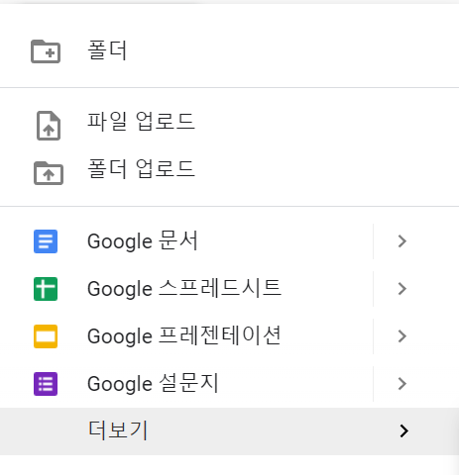



실습 환경 구성
[1] 웹 브라우저에서 Google 로그인
[2] 구글 드라이브 접속 (drive.google.com)
[3] 구글 colab 설치 (아래 사진 참고)
4
1
3
5
2
6

Slide 6

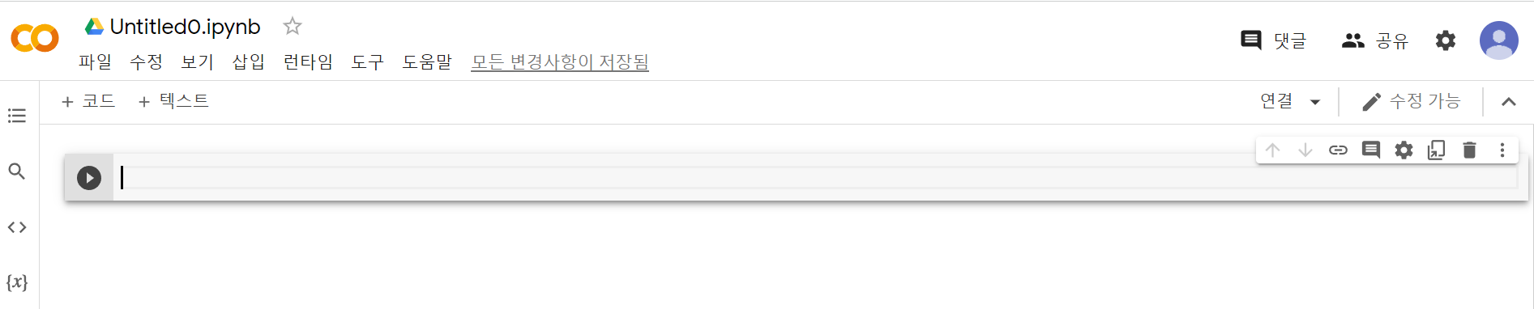
실습 환경 구성
[4] 구글 드라이브 내 실습 코드를 보관할 폴더 생성 (띄어쓰기, 한글 사용 X)
[5] 구글 Colab 실행
2
1
4
3
Colab 실행 화면

Slide 7
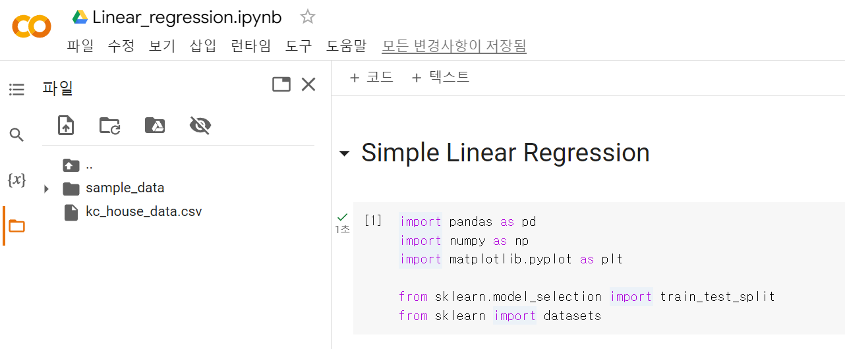
Base Code 다운로드
LMS 강의콘텐츠 4주차 1차시 Base code 및 데이터셋 다운로드
1
2
데이터셋 업로드

Slide 8
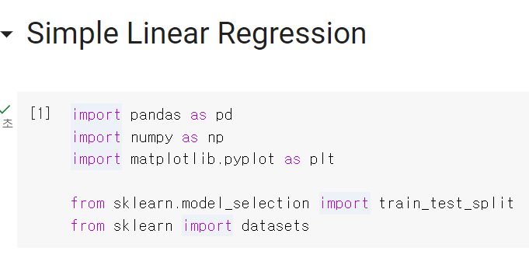
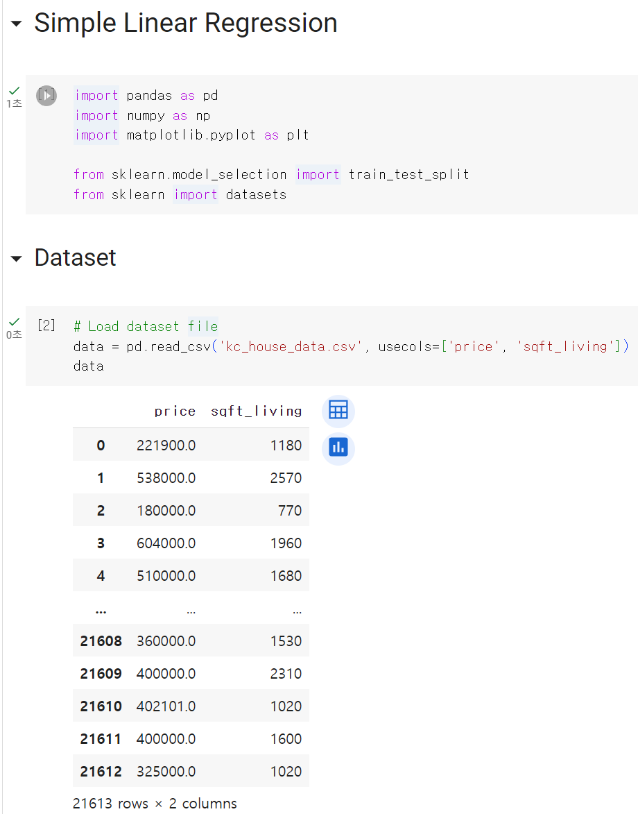
실습 – Single Linear Regression
Single Linear Regression을 위한 데이터셋 확인
Y: 정답 데이터 (price)
X: 입력 데이터 (sqft_living)

Slide 9
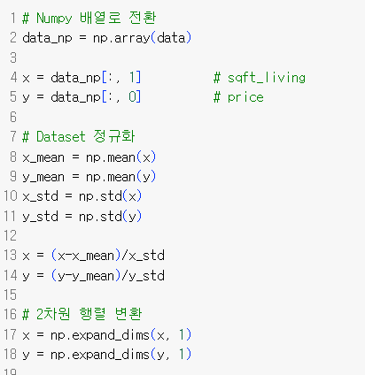
실습 – Single Linear Regression
Single Linear Regression을 위한 데이터셋 확인
X, Y 값의 scale이 너무 큰 경우 학습이 잘 안될 수 있음
→ Gaussian 정규화 수행

Slide 10
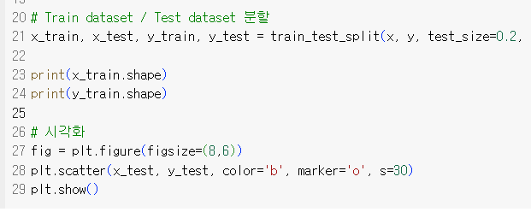
실습 – Single Linear Regression
Single Linear Regression을 위한 데이터셋 확인
Train dataset : Test dataset = 8 : 2 로 분할

Slide 11
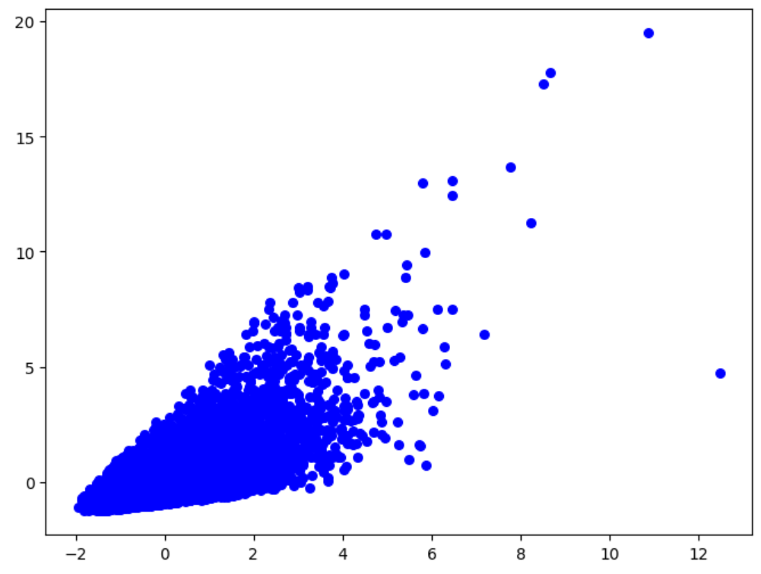
실습 – Single Linear Regression
Single Linear Regression을 위한 데이터셋 확인
Y: price
X: sqft_living

Slide 12
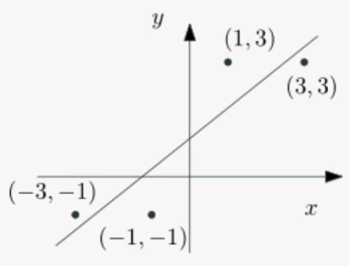
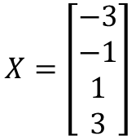
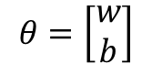
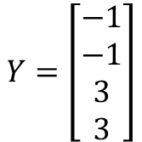
Review – Least Squares Method
Solutions
Ordinary Least Squares (OLS) = Least Squares Method (LSM) = Normal Equation
Gradient Descent Method
$$X=\left[\begin{aligned}−3 \\ −1 \\ 1 \\ 3\end{aligned}\right]$$
$$Y=\left[\begin{aligned}−1 \\ −1 \\ 3 \\ 3\end{aligned}\right]$$
(x₃, y₃)
$$θ=\left[\begin{aligned}w \\ b\end{aligned}\right]$$
4x1
4x1
2x1
(x₄, y₄)
(x₁, y₁)
(x₂, y₂)

Slide 13
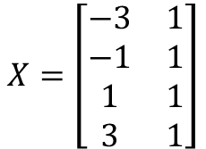
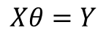
Review – Least Squares Method
Solutions
Ordinary Least Squares (OLS) = Least Squares Method (LSM) = Normal Equation
Gradient Descent Method
bias
$$X=\left[\begin{matrix}−3 & 1 \\ −1 & 1 \\ 1 & 1 \\ 3 & 1\end{matrix}\right]$$
$$Y=\left[\begin{aligned}−1 \\ −1 \\ 3 \\ 3\end{aligned}\right]$$
(x₃, y₃)
$$θ=\left[\begin{aligned}w \\ b\end{aligned}\right]$$
4x2
4x1
2x1
(x₄, y₄)
$$Xθ=Y$$
(x₁, y₁)
(x₂, y₂)

Slide 14
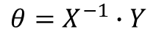
Review – Least Squares Method
Solutions
Ordinary Least Squares (OLS) = Least Squares Method (LSM) = Normal Equation
Gradient Descent Method
bias
$$X=\left[\begin{matrix}−3 & 1 \\ −1 & 1 \\ 1 & 1 \\ 3 & 1\end{matrix}\right]$$
$$Y=\left[\begin{aligned}−1 \\ −1 \\ 3 \\ 3\end{aligned}\right]$$
(x₃, y₃)
$$θ=\left[\begin{aligned}w \\ b\end{aligned}\right]$$
4x2
4x1
2x1
(x₄, y₄)
$$Xθ=Y$$
$$θ=X^{−1}∙Y$$
→ X가 정방행렬이 아니기 때문에 불가능
(x₁, y₁)
(x₂, y₂)

Slide 15
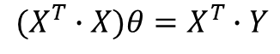
Review – Least Squares Method
Solutions
Ordinary Least Squares (OLS) = Least Squares Method (LSM) = Normal Equation
Gradient Descent Method
bias
$$X=\left[\begin{matrix}−3 & 1 \\ −1 & 1 \\ 1 & 1 \\ 3 & 1\end{matrix}\right]$$
$$Y=\left[\begin{aligned}−1 \\ −1 \\ 3 \\ 3\end{aligned}\right]$$
(x₃, y₃)
$$θ=\left[\begin{aligned}w \\ b\end{aligned}\right]$$
4x2
4x1
2x1
(x₄, y₄)
$$Xθ=Y$$
$$(X^{T}∙X)θ=X^{T}∙Y$$
(x₁, y₁)
(x₂, y₂)

Slide 16
Review – Least Squares Method
Solutions
Ordinary Least Squares (OLS) = Least Squares Method (LSM) = Normal Equation
Gradient Descent Method
bias
$$X=\left[\begin{matrix}−3 & 1 \\ −1 & 1 \\ 1 & 1 \\ 3 & 1\end{matrix}\right]$$
$$Y=\left[\begin{aligned}−1 \\ −1 \\ 3 \\ 3\end{aligned}\right]$$
(x₃, y₃)
$$θ=\left[\begin{aligned}w \\ b\end{aligned}\right]$$
4x2
4x1
2x1
(x₄, y₄)
$$Xθ=Y$$
$$(X^{T}∙X)θ=X^{T}∙Y$$
(x₁, y₁)
$${\left(X^{T}∙X\right)}^{−1}∙(X^{T}∙X)θ={\left(X^{T}∙X\right)}^{−1}∙(X^{T}∙Y)$$
(x₂, y₂)

Slide 17
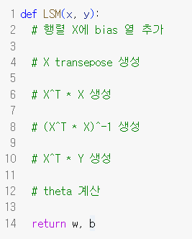
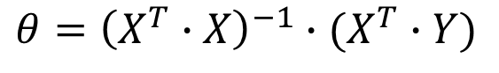
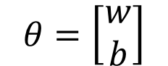
실습 – Least Squares Method
Solutions
Ordinary Least Squares (OLS) = Least Squares Method (LSM) = Normal Equation
Gradient Descent Method
$$θ=\left[\begin{aligned}w \\ b\end{aligned}\right]$$
$$θ={\left(X^{T}∙X\right)}^{−1}∙(X^{T}∙Y)$$

Slide 18
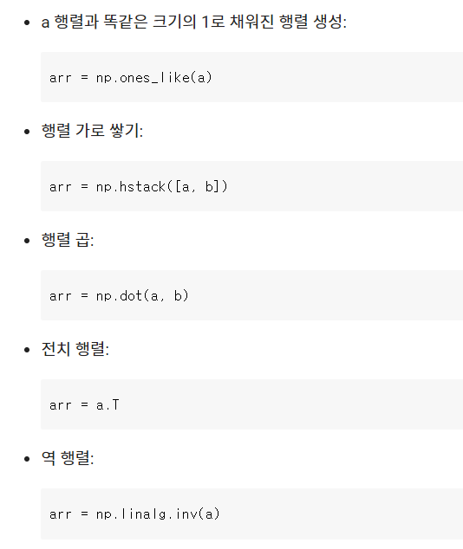
실습 – Least Squares Method
Solutions
Ordinary Least Squares (OLS) = Least Squares Method (LSM) = Normal Equation
Gradient Descent Method

Slide 19
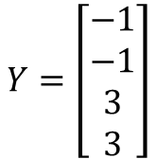
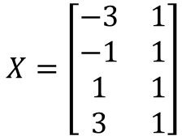
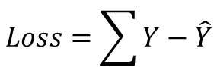
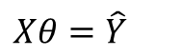
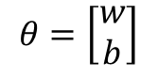
Review – Gradient Descent
Solutions
Ordinary Least Squares (OLS) = Least Squares Method (LSM) = Normal Equation
Gradient Descent Method
bias
Loss(θ)
$$X=\left[\begin{matrix}−3 & 1 \\ −1 & 1 \\ 1 & 1 \\ 3 & 1\end{matrix}\right]$$
$$Y=\left[\begin{aligned}−1 \\ −1 \\ 3 \\ 3\end{aligned}\right]$$
$$θ=\left[\begin{aligned}w \\ b\end{aligned}\right]$$
초기 지점
4x2
4x1
2x1
$$Xθ=\hat{Y}$$
$$Loss=\sum{Y−\hat{Y}}$$
θ
optimal θ

Slide 20
Review – Gradient Descent
Solutions
Ordinary Least Squares (OLS) = Least Squares Method (LSM) = Normal Equation
Gradient Descent Method
bias
Loss(θ)
$$X=\left[\begin{matrix}−3 & 1 \\ −1 & 1 \\ 1 & 1 \\ 3 & 1\end{matrix}\right]$$
$$Y=\left[\begin{aligned}−1 \\ −1 \\ 3 \\ 3\end{aligned}\right]$$
$$θ=\left[\begin{aligned}w \\ b\end{aligned}\right]$$
4x2
4x1
2x1
Loss가 최소인 위치의
θ를 구하는 것이 목표
$$Xθ=\hat{Y}$$
$$Loss=\sum{Y−\hat{Y}}$$
θ
optimal θ

Slide 21
Review – Gradient Descent
Solutions
Ordinary Least Squares (OLS) = Least Squares Method (LSM) = Normal Equation
Gradient Descent Method
Gradient Descent algorithm
현재 지점에서 미분을 이용해 gradient 계산
Gradient에 learning rate를 곱하고 반대 방향으로 weight update
Loss(θ)
Gradient = 0.8
Gradient = 0
θ
optimal θ
Learning rate
Gradient

Slide 22
Review – Gradient Descent
Solutions
Ordinary Least Squares (OLS) = Least Squares Method (LSM) = Normal Equation
Gradient Descent Method
Gradient Descent algorithm
현재 지점에서 미분을 이용해 gradient 계산
Gradient에 learning rate를 곱하고 반대 방향으로 weight update
Loss(θ)
Learning rate = 0.1
Gradient = 0.8
θ
optimal θ

Slide 23
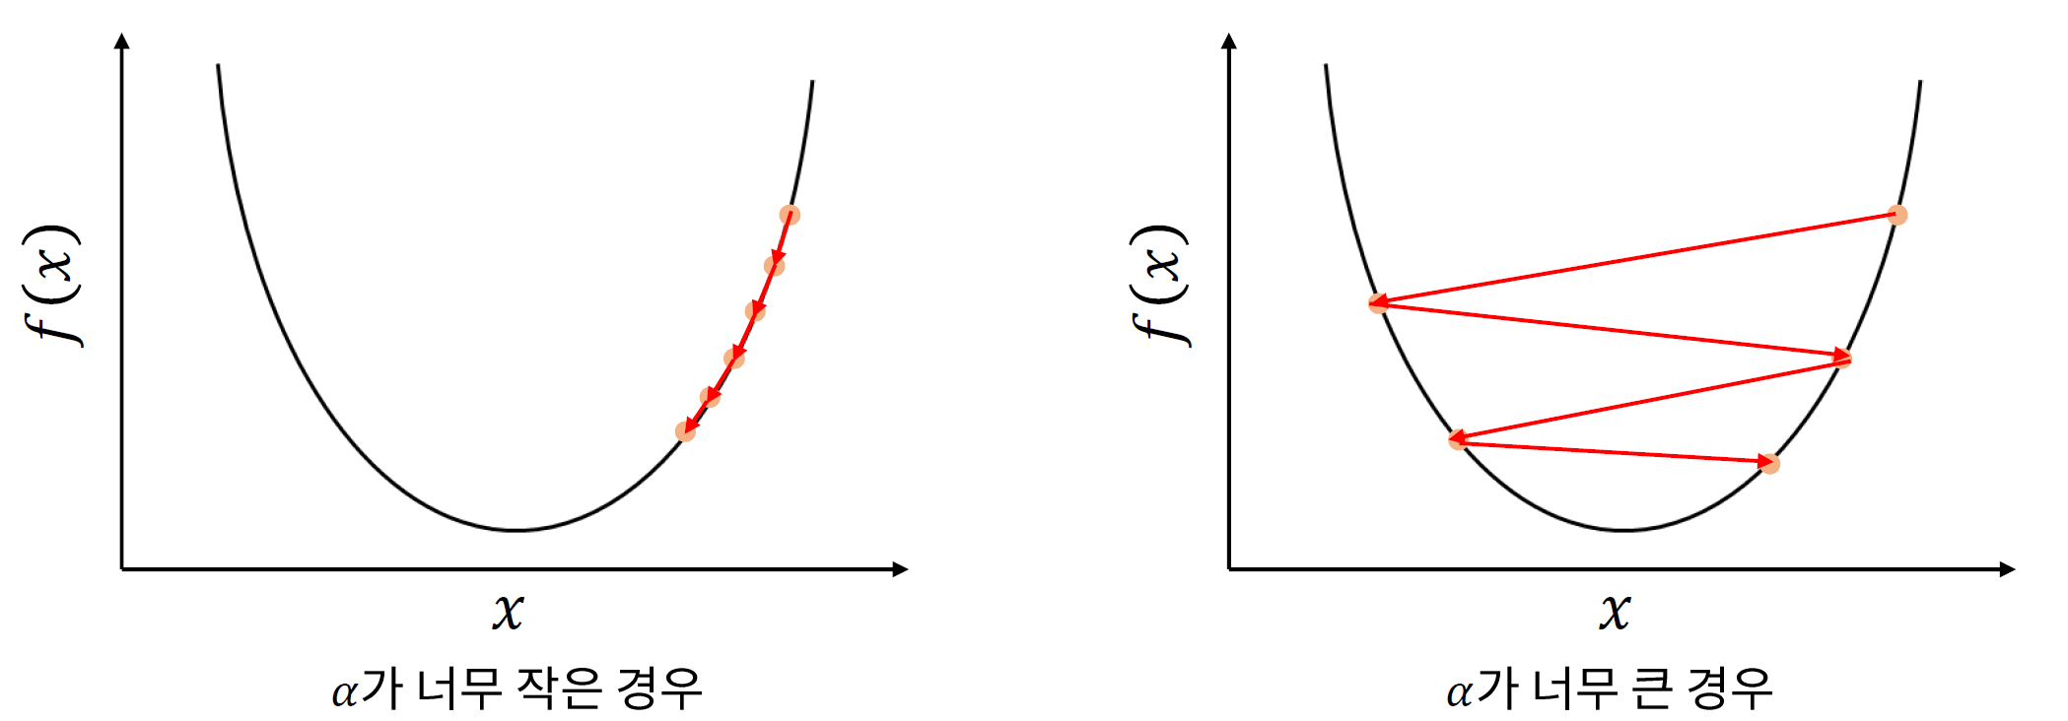
Review – Gradient Descent
Solutions
Ordinary Least Squares (OLS) = Least Squares Method (LSM) = Normal Equation
Gradient Descent Method
Learning rate: 파라미터를 얼마나 업데이트할 지 정하는 하이퍼파라미터
α: Learning rate

Slide 24
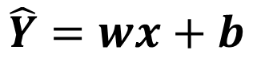
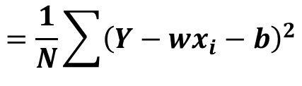
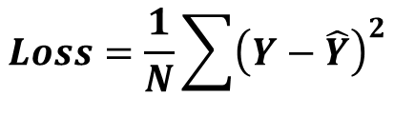
Review – Gradient Descent
Gradient Descent Method (Parameter update)
$$\hat{Y}=wx+b$$
$$Loss=\frac{1}{N}\sum{{\left(Y−\hat{Y}\right)}^{2}}$$
$$=\frac{1}{N}\sum{{\left(Y−wx_{i}−b\right)}^{2}}$$

Slide 25
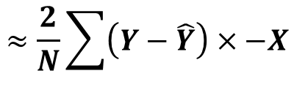
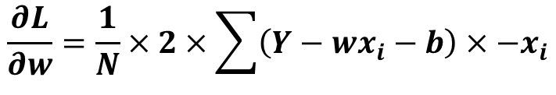
Review – Gradient Descent
Gradient Descent Method (Parameter update)
$$\frac{∂L}{∂w}=\frac{1}{N}×2×\sum{\left(Y−wx_{i}−b\right)}×{−x}_{i}$$
$$\hat{Y}=wx+b$$
$$≈\frac{2}{N}\sum{\left(Y−\hat{Y}\right)×−X}$$
$$Loss=\frac{1}{N}\sum{{\left(Y−\hat{Y}\right)}^{2}}$$
$$=\frac{1}{N}\sum{{\left(Y−wx_{i}−b\right)}^{2}}$$

Slide 26
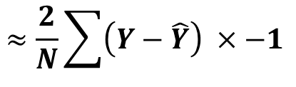
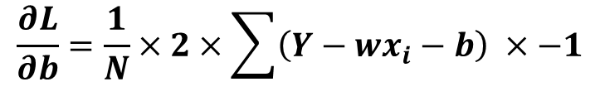
Review – Gradient Descent
Gradient Descent Method (Parameter update)
$$\frac{∂L}{∂w}=\frac{1}{N}×2×\sum{\left(Y−wx_{i}−b\right)}×{−x}_{i}$$
$$\hat{Y}=wx+b$$
$$≈\frac{2}{N}\sum{\left(Y−\hat{Y}\right)×−X}$$
$$Loss=\frac{1}{N}\sum{{\left(Y−\hat{Y}\right)}^{2}}$$
$$=\frac{1}{N}\sum{{\left(Y−wx_{i}−b\right)}^{2}}$$
$$\frac{∂L}{∂b}=\frac{1}{N}×2×\sum{\left(Y−wx_{i}−b\right) ×−1}$$
$$≈\frac{2}{N}\sum{\left(Y−\hat{Y}\right) ×−1 }$$

Slide 27
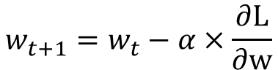
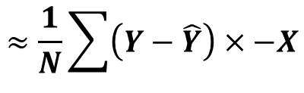
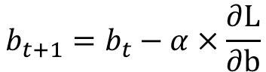
Review – Gradient Descent
Gradient Descent Method (Parameter update)
$$\frac{∂L}{∂w}=\frac{1}{N}×2×\sum{\left(Y−wx_{i}−b\right)}×{−x}_{i}$$
$$\hat{Y}=wx+b$$
$$≈\frac{1}{N}\sum{\left(Y−\hat{Y}\right)×−X}$$
$$Loss=\frac{1}{N}\sum{{\left(Y−\hat{Y}\right)}^{2}}$$
$$=\frac{1}{N}\sum{{\left(Y−wx_{i}−b\right)}^{2}}$$
$$\frac{∂L}{∂b}=\frac{1}{N}×2×\sum{\left(Y−wx_{i}−b\right) ×−1}$$
$$w_{t+1}=w_{t}−α×\frac{∂L}{∂w}$$
$$≈\frac{2}{N}\sum{\left(Y−\hat{Y}\right) ×−1 }$$
$$b_{t+1}=b_{t}−α×\frac{∂L}{∂b}$$

Slide 28
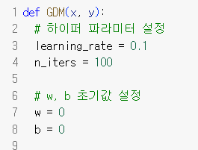
실습 – Gradient Descent
Single Linear Regression 모델 작성

Slide 29
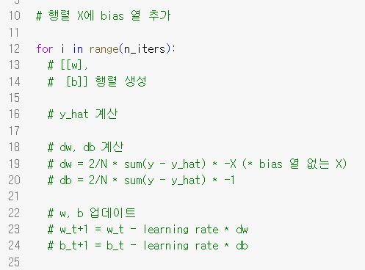
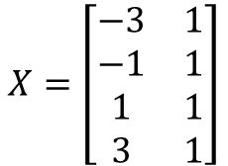
실습 – Gradient Descent
Single Linear Regression 모델 작성
bias
$$X=\left[\begin{matrix}−3 & 1 \\ −1 & 1 \\ 1 & 1 \\ 3 & 1\end{matrix}\right]$$
4x2

Slide 30
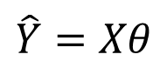
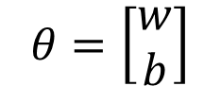
실습 – Gradient Descent
Single Linear Regression 모델 작성
$$θ=\left[\begin{aligned}w \\ b\end{aligned}\right]$$
$$\hat{Y}=Xθ$$

Slide 31
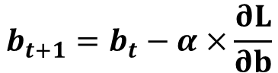
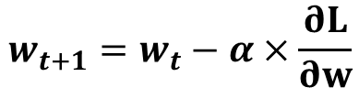
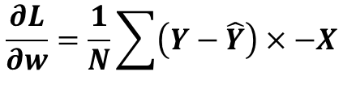
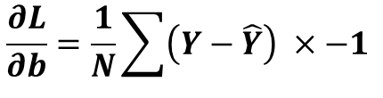
실습 – Gradient Descent
Single Linear Regression 모델 작성
$$\frac{∂L}{∂w}=\frac{1}{N}\sum{\left(Y−\hat{Y}\right)×−X}$$
$$\frac{∂L}{∂b}=\frac{1}{N}\sum{\left(Y−\hat{Y}\right) ×−1 }$$
$$w_{t+1}=w_{t}−α×\frac{∂L}{∂w}$$
$$b_{t+1}=b_{t}−α×\frac{∂L}{∂b}$$

Slide 32
Dongsan Jun (dsjun@dau.ac.kr)
Image Signal Processing Laboratory (www.donga-ispl.kr)
Dept. of Computer Engineering
Dong-A University, Busan, Rep. of Korea

